Slide 1
Convolutional Networks Architectures and Application
Dr. Gahangir Hossain
Texas A&M University-Kingsville
Slides from: https://www.cse.ust.hk/~quan/comp5421/notes/cnn.pptx

Slide 2
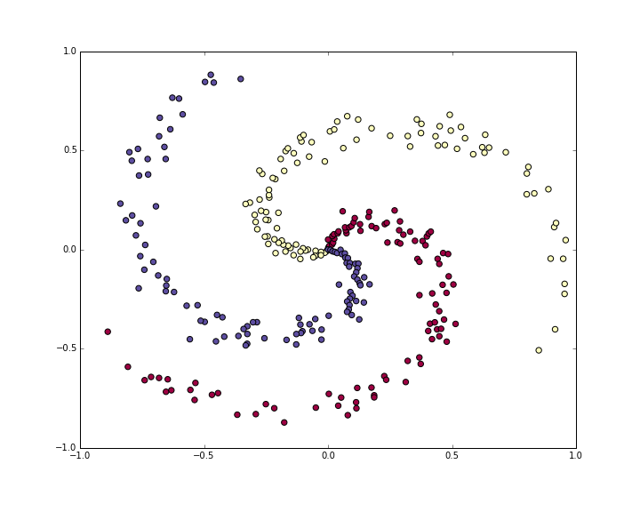
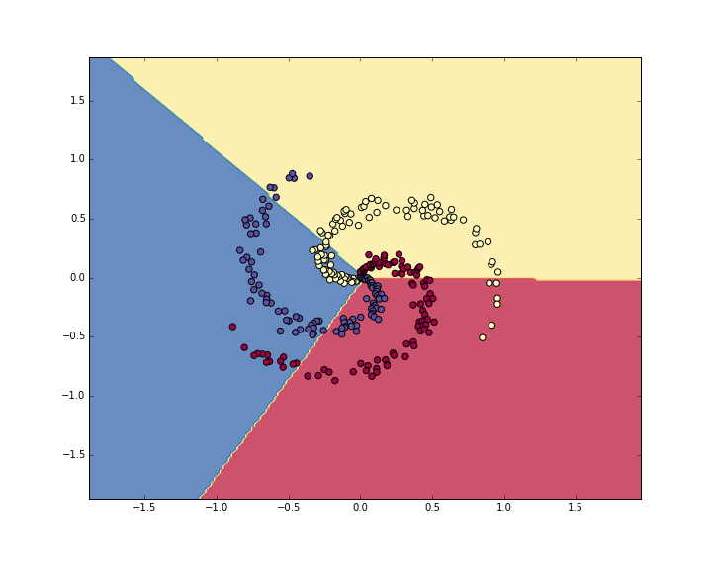
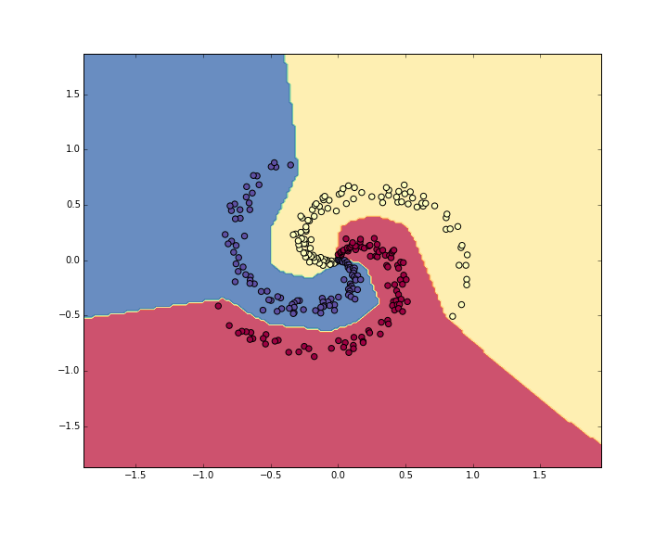
A toy example
The toy spiral data consists of three classes (blue, red, yellow) that are not linearly separable.
3 classes, 100 pts for each class
Softmax linear classifier fails to learn the toy spiral dataset.
One layer, W, 2*3, b,
analytical gradients, 190 iteration, loss from 1.09 to 0.78, 48% training set accuracy
Neural Network classifier crushes the spiral dataset.
One hidden layer of width 100, W1, 2*100, b1, W2, 100*3, only few extra lines of python codes!
9000 iteration, loss from 1.09 to 0.24, 98% training set accuracy

Slide 3
Generalization
The ‘optimization’ reduces the training errors (or residual errors before)
The ‘machine learning’ wants to reduce the generalization error or the test error as well.
The generalization error is the expected value of the error on a new input, from the test set.
Make the training error small.
Make the gap between training and test error small.
Underfitting is not able to have sufficiently low error on the training set
Overfitting is not able to narrow the gap between the training and the test error.
Notes:
The expansion of log p typically yields some terms that do not depend on the model parameters and may be discarded. If p is normal, then we recover the mean squred error cost, J = E || y – f (x, theta) ||^2 + c, up to a scaling factor and a term that does not depend on theta.

Slide 4
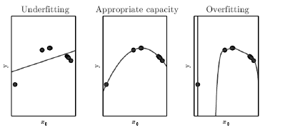
The training data was generated synthetically, by randomly sampling x values and choosing y deterministically
by evaluating a quadratic function. (Left) A linear function fit to the data suffers from
underfitting. (Center) A quadratic function fit to the data generalizes well to unseen points. It does not suffer from
a significant amount of overfitting or underfitting. (Right) A polynomial of degree 9 fit to
the data suffers from overfitting. Here we used the Moore-Penrose pseudoinverse to solve
the underdetermined normal equations. The solution passes through all of the training
points exactly, but we have not been lucky enough for it to extract the correct structure.
Notes:
The expansion of log p typically yields some terms that do not depend on the model parameters and may be discarded. If p is normal, then we recover the mean squred error cost, J = E || y – f (x, theta) ||^2 + c, up to a scaling factor and a term that does not depend on theta.

Slide 5
The capacity of a model
The old Occam’s razor. Among competing ones, we should choose the “simplest” one.
The modern VC Vapnik-Chervonenkis dimension. The largest possible value of m for which there exists a training set of m different x points that the binary classifier can label arbitrarily.
The no-free lunch theorem. No best learning algorithms, no best form of regularization. Task specific.
Notes:
The expansion of log p typically yields some terms that do not depend on the model parameters and may be discarded. If p is normal, then we recover the mean squred error cost, J = E || y – f (x, theta) ||^2 + c, up to a scaling factor and a term that does not depend on theta.

Slide 6

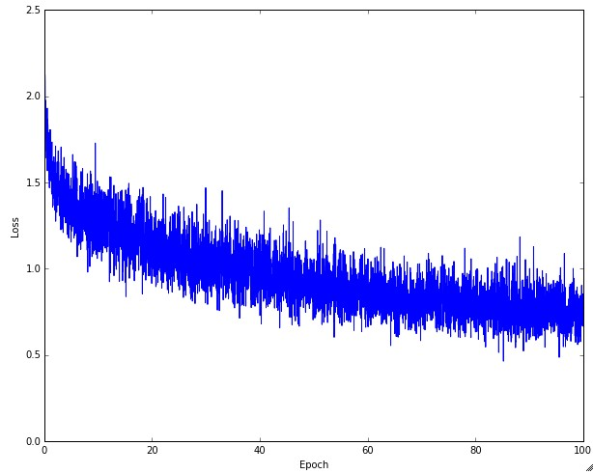
Practice: learning rate
Left: A cartoon depicting the effects of different learning rates. With low learning rates the improvements will be linear. With high learning rates they will start to look more exponential. Higher learning rates will decay the loss faster, but they get stuck at worse values of loss (green line). This is because there is too much "energy" in the optimization and the parameters are bouncing around chaotically, unable to settle in a nice spot in the optimization landscape. Right: An example of a typical loss function over time, while training a small network on CIFAR-10 dataset. This loss function looks reasonable (it might indicate a slightly too small learning rate based on its speed of decay, but it's hard to say), and also indicates that the batch size might be a little too low (since the cost is a little too noisy).

Slide 7
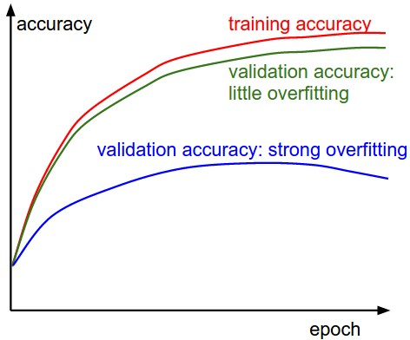
Practice: avoid overfitting
The gap between the training and validation accuracy indicates the amount of overfitting. Two possible cases are shown in the diagram on the left. The blue validation error curve shows very small validation accuracy compared to the training accuracy, indicating strong overfitting. When you see this in practice you probably want to increase regularization or collect more data. The other possible case is when the validation accuracy tracks the training accuracy fairly well. This case indicates that your model capacity is not high enough: make the model larger by increasing the number of parameters.

Slide 8
Why deeper?
Deeper networks are able to use far fewer units per layer and far fewer parameters, as well as frequently generalizing to the test set
But harder to optimize!
Choosing a deep model encodes a very general belief that the function we want to learn involves composition of several simpler functions. Or the learning consists of discovering a set of underlying factors of variation that can in turn be described in terms of other, simpler underlying factors of variation.

Slide 9
Curse of dimensionality
The core idea in deep learning is that we assume that the data was generated by the composition factors or features, potentially at multiple levels in a hierarchy.
This assumption allows an exponential gain in the relationship between the number of examples and the number of regions that can be distinguished.
The exponential advantages conferred by the use of deep, distributed representations counter the exponential challenges posed by the curse of dimensionality.

Slide 10
Convolutional Neural Networks, or CNN, a visual network, and back to a 2D lattice from the abstraction of the 1D feature vector x in neural networks

Slide 11
From a regular network to CNN
We have regarded an input image as a vector of features, x, by virtue of feature detection and selection, like other machine learning applications to learn f(x)
We now regard it as is, a 2D image, a 2D grid, a topological discrete lattice, I(I,j)
Converting input images into feature vector loses the spatial neighborhood-ness
complexity increases to cubics
Yet, the connectivities become local to reduce the complexity!

Slide 12
What is a convolution?
The fundamental operation, the convolution I * K(I,j) = \sum \sum
Flipping kernels makes the convolution commutative, which is fundamental in theory, but not required in NN to compose with other functions, so to include discrete correlations as well into “convolution”
Convolution is a linear operator, dot-product like correlation, not a matrix multiplication, but can be implemented as a sparse matrix multiplication, to be viewed as an affine transform

Slide 13
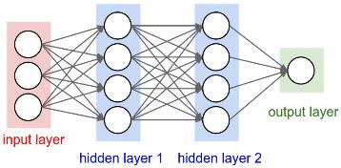
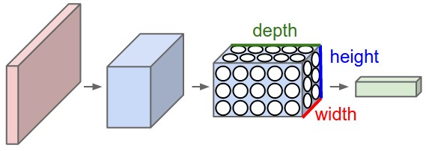
A regular 3-layer Neural Network.
A CNN arranges its neurons in three dimensions (width, height, depth). Every layer of a CNN transforms the 3D input volume to a 3D output volume. In this example, the red input layer holds the image, so its width and height would be the dimensions of the image, and the depth would be 3 (Red, Green, Blue channels).

Slide 14
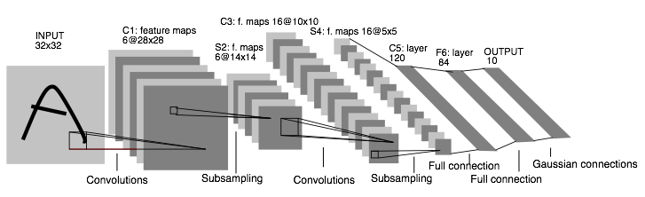
Convolutional Neural Networks: 1998. Input 32*32. CPU
LeNet: a layered model composed of convolution and subsampling operations followed by a holistic representation and ultimately a classifier for handwritten digits. [ LeNet ]

Slide 15
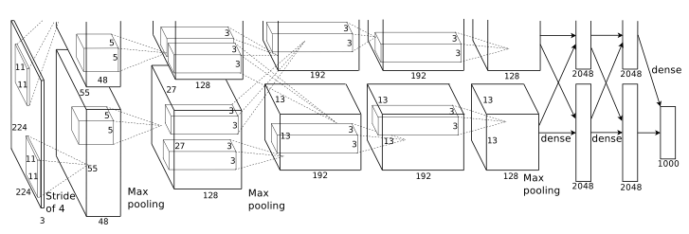
Convolutional Neural Networks: 2012. Input 224*224*3. GPU.
AlexNet: a layered model composed of convolution, subsampling, and further operations followed by a holistic representation and all-in-all a landmark classifier on
ILSVRC12. [ AlexNet ]
+ data
+ gpu
+ non-saturating nonlinearity
+ regularization

Slide 16
LeNet vs AlexNet
32*32*1
7 layers
2 conv and 4 classification
60 thousand parameters
Only two complete convolutional layers
Conv, nonlinearities, and pooling as one complete layer
224*224*3
8 layers
5 conv and 3 fully classification
5 convolutional layers, and 3,4,5 stacked on top of each other
Three complete conv layers
60 million parameters, insufficient data
Data augmentation:
Patches (224 from 256 input), translations, reflections
PCA, simulate changes in intensity and colors

Slide 17
The motivation of convolutions
Sparse interaction, or Local connectivity.
The receptive field of the neuron, or the filter size.
The connections are local in space (width and height), but always full in depth
A set of learnable filters
Parameters sharing, the weights are tied
Equivariant representation, translation invariant

Slide 18
Convolution and matrix multiplication
Discrete convolution can be viewed as multiplication by matrix
The kernel is a doubly block circulant matrix
It is very sparse!

Slide 19
The ‘convolution’ operation
The convolution is commutative because we have flipped the kernel
Many implement a cross-correlation without flipping
A convolution can be defined for 1, 2, 3, and N D
The 2D convolution is different from a real 3D convolution, which integrates the spatio-temporal information, the standard CNN convolution has only ‘spatial’ spreading
In CNN, even for 3D RGB input images, the standard convolution is 2D in each channel,
each channel has a different filter or kernel, the convolution per channel is then summed up in all channels to produce a scalar for non-linearity activation
The filiter in each channel is not normalized, so no need to have different linear combination coefficients.
1*1 convolution is a dot product in different channel, a linear combination of different chanels
The backward pass of a convolution is also a convolution with spatially flipped filters.

Slide 20
The convolution layers
Stacking several small convolution layers is different from convolution cascating
As each small convolution is followed by the nonlinearities ReLU
The nonlinearities make the features more expressive!
Have fewer parameters with small filters, but more memory.
Cascating simply enlarges the spatial extent, the receptive field
Whether each conv layer is also followed by a pooling?
Lenet does not!
AlexNet first did not.

Slide 21
The Pooling Layer
Reduce the spatial size
Reduce the amount of parameters
Avoid over-fitting
Backpropagation for a max: only routing the gradient to the input that had the highest value in the forward pass
It is unclear whether the pooling is essential.

Slide 22
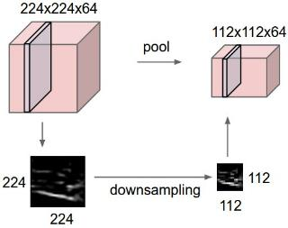
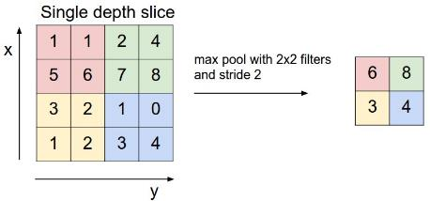
Pooling layer down-samples the volume spatially, independently in each depth slice of the input volume.
Left: the input volume of size [224x224x64] is pooled with filter size 2, stride 2 into output volume of size [112x112x64]. Notice that the volume depth is preserved.
Right: The most common down-sampling operation is max, giving rise to max pooling, here shown with a stride of 2. That is, each max is taken over 4 numbers (little 2x2 square).

Slide 23
The spatial hyperparameters
Depth
Stride
Zero-padding

Slide 24
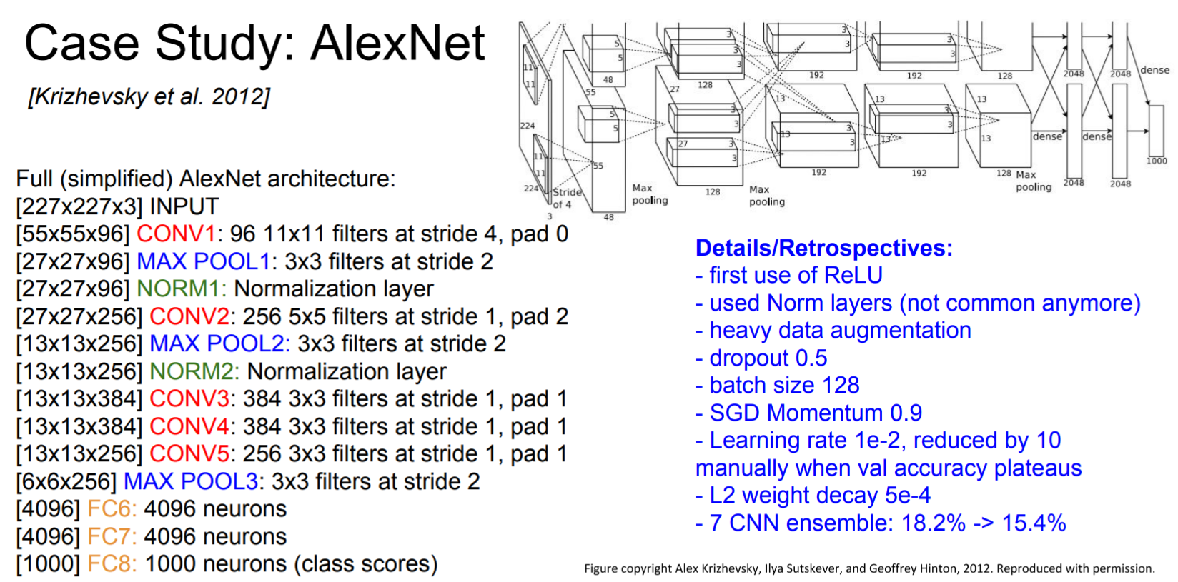
AlexNet 2012
A strong prior has very low entropy, e.g. a Gaussian with low variance
An infinitely strong prior says that some parameters are forbidden, and places zero probability on them
The convolution ‘prior’ says the identical and zero weights
The pooling forces the invariance of small translations

Slide 25
The convolution and pooling act as an infinitely strong prior!
A strong prior has very low entropy, e.g. a Gaussian with low variance
An infinitely strong prior says that some parameters are forbidden, and places zero probability on them
The convolution ‘prior’ says the identical and zero weights
The pooling forces the invariance of small translations

Slide 26
The neuroscientific basis for CNN
The primary visual cortex, V1, about which we know the most
The brain region LGN, lateral geniculate nucleus, at the back of the head carries the signal from the eye to V1, a convolutional layer captures three aspects of V1
It has a 2-dimensional structure
V1 contains many simple cells, linear units
V1 has many complex cells, corresponding to features with shift invariance, similar to pooling
When viewing an object, info flows from the retina, through LGN, to V1, then onward to V2, then V4, then IT, inferotemporal cortex, corresponding to the last layer of CNN features
Not modeled at all. The mammalian vision system develops an attention mechanism
The human eye is mostly very low resolution, except for a tiny patch fovea.
The human brain makes several eye movements saccades to salient parts of the scene
The human vision perceives 3D
A simple cell responds to a specific spatial frequency of brightness in a specific direction at a specific location --- Gabor-like functions

Slide 27
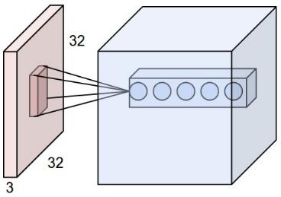
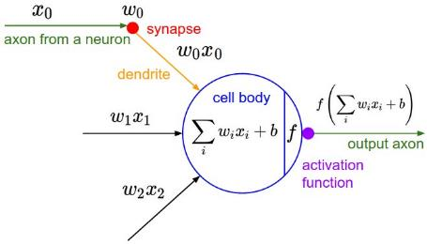
Receptive field
Left: An example input volume in red (e.g. a 32x32x3 CIFAR-10 image), and an example volume of neurons in the first Convolutional layer. Each neuron in the convolutional layer is connected only to a local region in the input volume spatially, but to the full depth (i.e. all color channels). Note, there are multiple neurons (5 in this example) along the depth, all looking at the same region in the input - see discussion of depth columns in text below. Right: The neurons from the Neural Network chapter remain unchanged: They still compute a dot product of their weights with the input followed by a non-linearity, but their connectivity is now restricted to be local spatially.

Slide 28
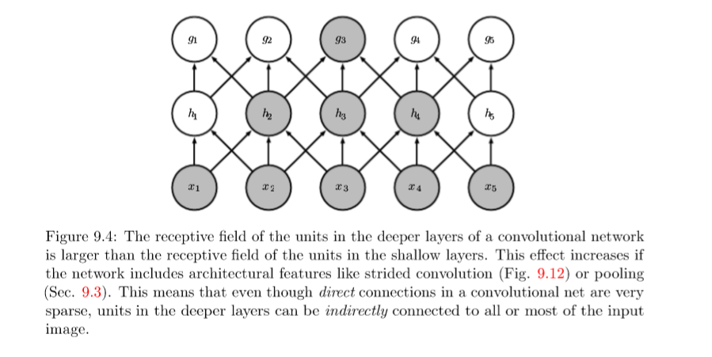
Receptive field

Slide 29
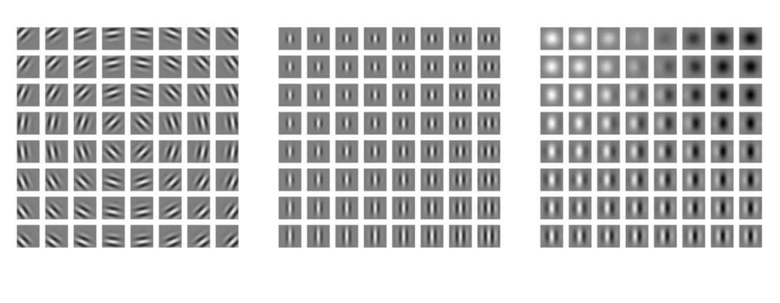
Gabor functions

Slide 30
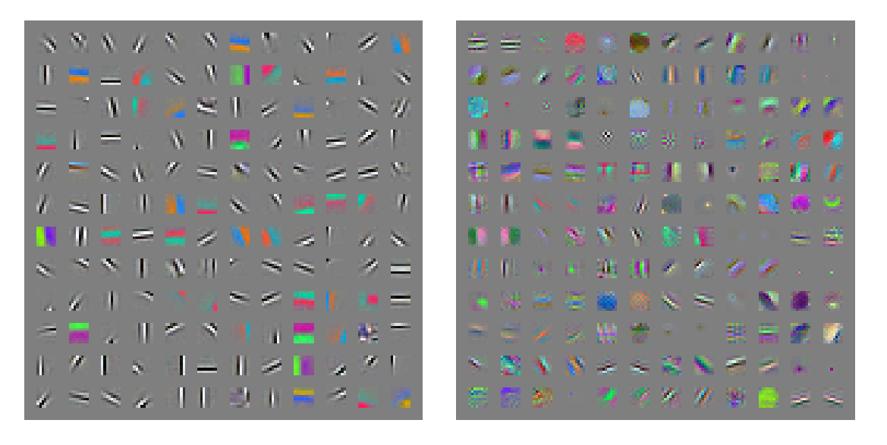
Gabor-like learned features

Slide 31
CNN architectures and algorithms

Slide 32
CNN architectures
The conventional linear structure, linear list of layers, feedforward
Generally a DAG, directed acyclic graph
ResNet simply adds back
Different terminology: complex layer and simple layer
A complex (complete) convolutional layer, including different stages such as convolution per se, batch normalization, nonlinearity, and pooling
Each stage is a layer, even there are no parameters
The traditional CNNs are just a few complex convolutional layers to extract features, then are followed by a softmax classification output layer
Convolutional networks output a high-dimensional, structured object, rather than just predicting a class label for a classiciation task or a real valuefor a regression task, it it an output tensor
S_i,j,k is the probability that pixel j,k belongs to class I
Notes:
http://cs231n.github.io/neural-networks-1/

Slide 33
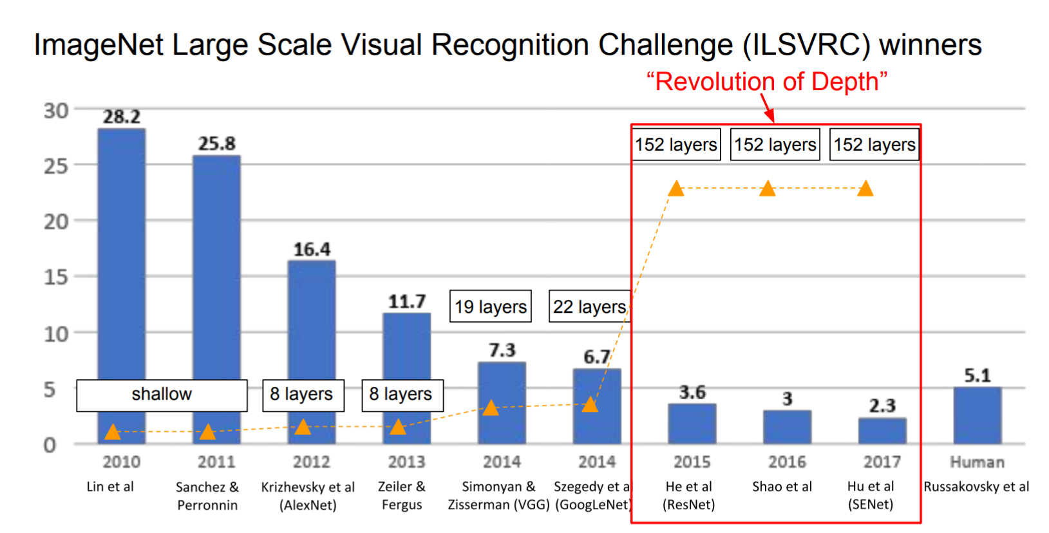
The popular CNN
LeNet, 1998
AlexNet, 2012
VGGNet, 2014
ResNet, 2015
Notes:
http://cs231n.github.io/neural-networks-1/

Slide 34
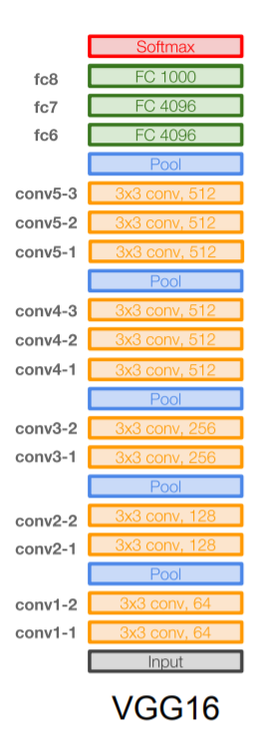
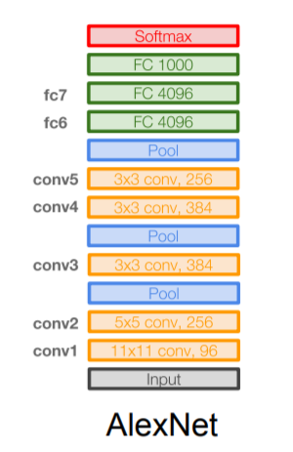
VGGNet
16 layers
Only 3*3 convolutions
138 million parameters

Slide 35
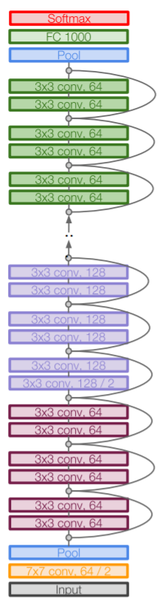
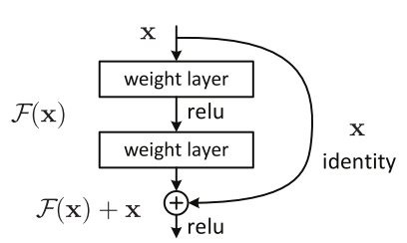
ResNet
152 layers
ResNet50

Slide 36
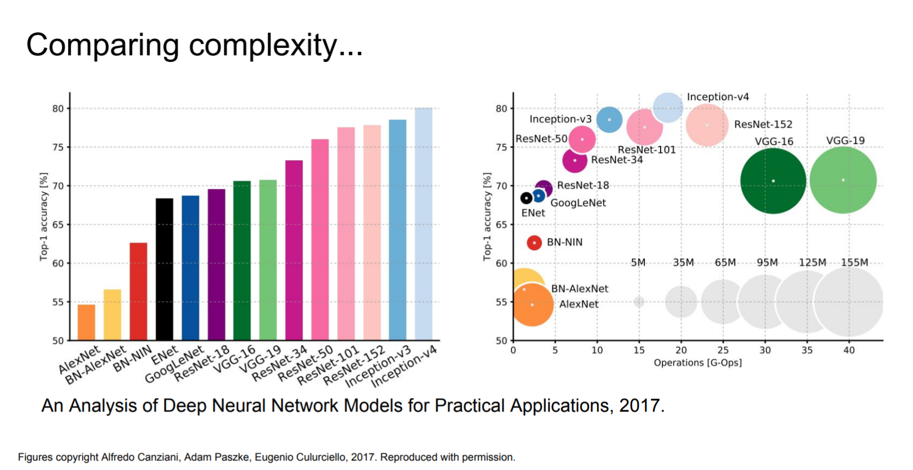
Computational complexity
The memory bottleneck
GPU, a few GB

Slide 37
Stochastic Gradient Descent
Gradient descent, follows the gradient of an entire training set downhill
Stochastic gradient descent, follows the gradient of randomly selected minbatches downhill

Slide 38
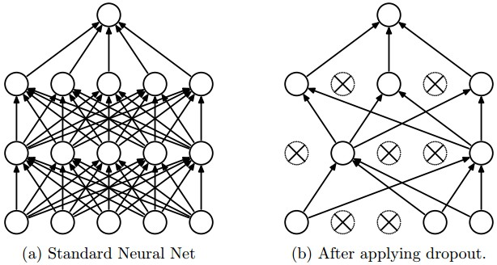
The dropout regularization
Randomly shutdown a subset of units in training
It is a sparse representation
It is a different net each time, but all nets share the parameters
A net with n units can be seen as a collection of 2^n possible thinned nets, all of which share weights.
At test time, it is a single net with averaging
Avoid over-fitting

Slide 39
Ensemble methods
Bagging (bootstrap aggregating), model averaging, ensemble methods
Model averaging outperforms, with increased computation and memory
Model averaging is discouraged when benchmarking for publications
Boosting, an ensemble method, constructs an ensemble with higher capacity than the individual models

Slide 40
Batch normalization
After convolution, before nonlinearity
‘Batch’ as it is done for a subset of data
Instead of 0-1 (zero mean unit variance) input, the distribution will be learnt, even undone if necessary
The data normalization or PCA/whitening is common in general NN, but in CNN, the ‘normalization layer’ has been shown to be minimal in some nets as well.

Slide 41
Open questions
Networks are non-convex
Need regularization
Smaller networks are hard to train with local methods
Local minima are bad, in loss, not stable, large variance
Bigger ones are easier
More local minima, but better, more stable, small variance
As big as the computational power, and data!

Slide 42
Local minima, saddle points, and plateaus?
We don’t care about finding the exact mimimum, we only want to obtain good generalization error by reducing the function value.
In low-dimensional, local minima are common.
In higher dimensional, local minima are rare, and saddle points are more common.
The Hessian at a local mimimum has all positive eigenvalues. The Hessian at a saddle point has a micture of pos and neg eigenvalues.
It is exponentially unlikely that all n will have the same sign in high n-dim

Slide 43
Convolutional Networks Application

Slide 44
CNN applications

Slide 45
CNN applications
Transfer learning
Fine-tuning the CNN
Keep some early layers
Early layers contain more generic features, edges, color blobs
Common to many visual tasks
Fine-tune the later layers
More specific to the details of the class
CNN as feature extractor
Remove the last fully connected layer
A kind of descriptor or CNN codes for the image
AlexNet gives a 4096 Dim descriptor
Notes:
http://cs231n.github.io/neural-networks-1/

Slide 46
CNN classification/recognition nets
CNN layers and fully-connected classification layers
From ResNet to DenseNet
Densely connected
Feature concatenation
Notes:
http://cs231n.github.io/neural-networks-1/

Slide 47
Fully convolutional nets: semantic segmentation
Classification/recognition nets produce ‘non-spatial’ outputs
the last fully connected layer has the fixed dimension of classes, throws away spatial coordinates
Fully convolutional nets output maps as well
Notes:
http://cs231n.github.io/neural-networks-1/

Slide 48
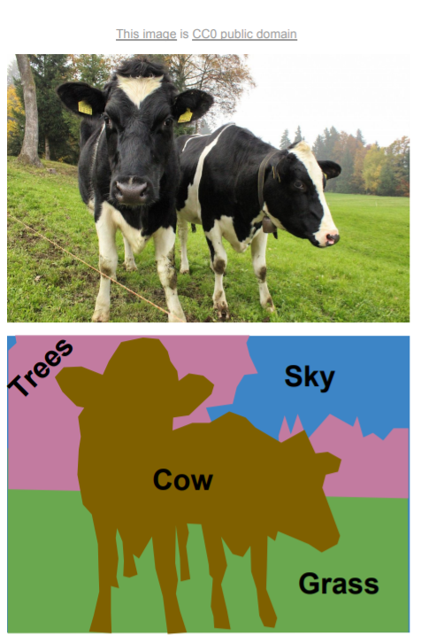
Semantic segmentation

Slide 49
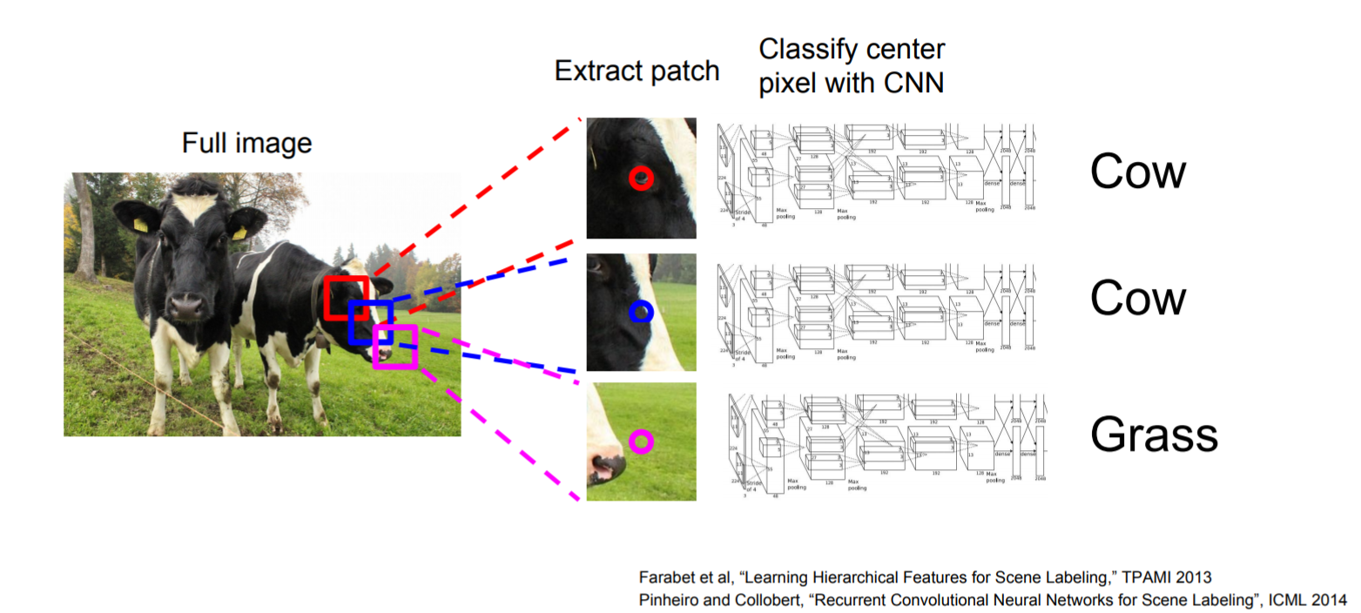
Using sliding windows for semantic segmentation

Slide 50
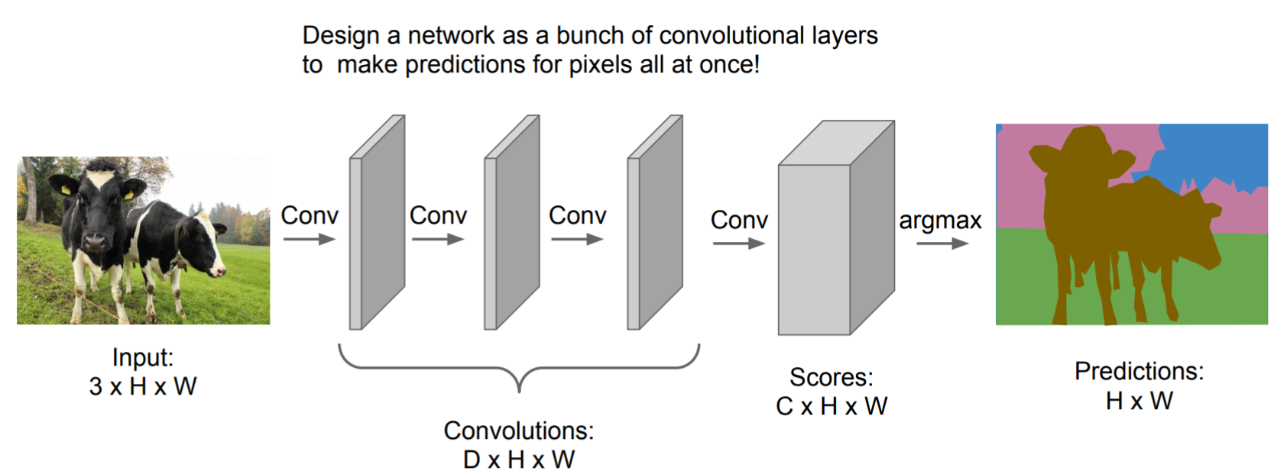
Fully convolutional

Slide 51
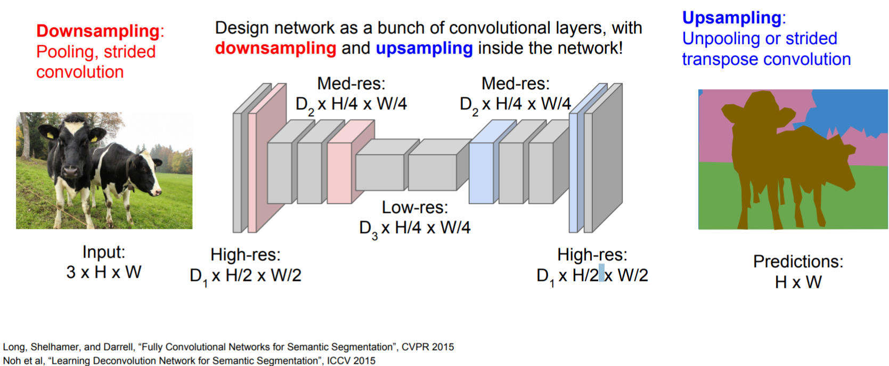
Fully convolutional

Slide 52
Detection and segmentation nets: The Mask Region-based CNN (R-CNN):
Class-independent region (bounding box) proposals
From selective search to region proposal net with objectness
Use CNN to class each region
Regression on the bounding box or contour segmentation
Mask R-CNN: end-to-end
Use CNN to make proposals on object/non-object in parallel
The old good idea of face detection by Viola
Proposal generation
Cascading (ada boosting)
Notes:
HOG features, Histogram of Gradients, by Triggs

Slide 53
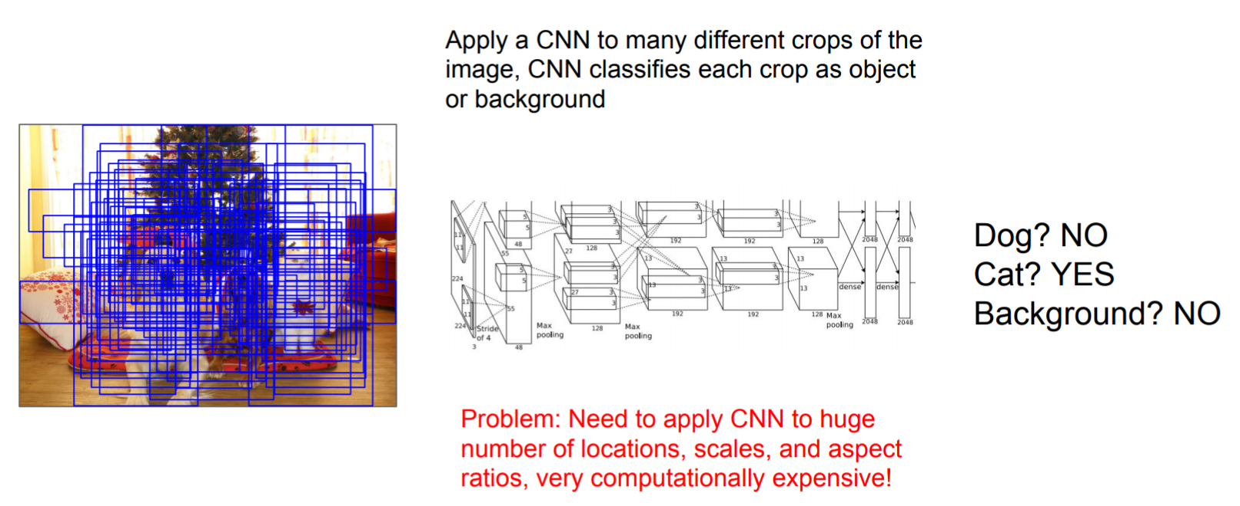
Using sliding windows for object detection as classification

Slide 54
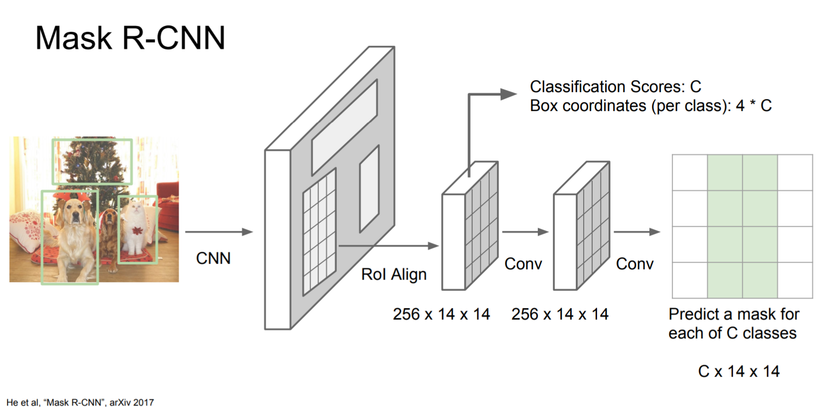
Mask R-CNN

Slide 55
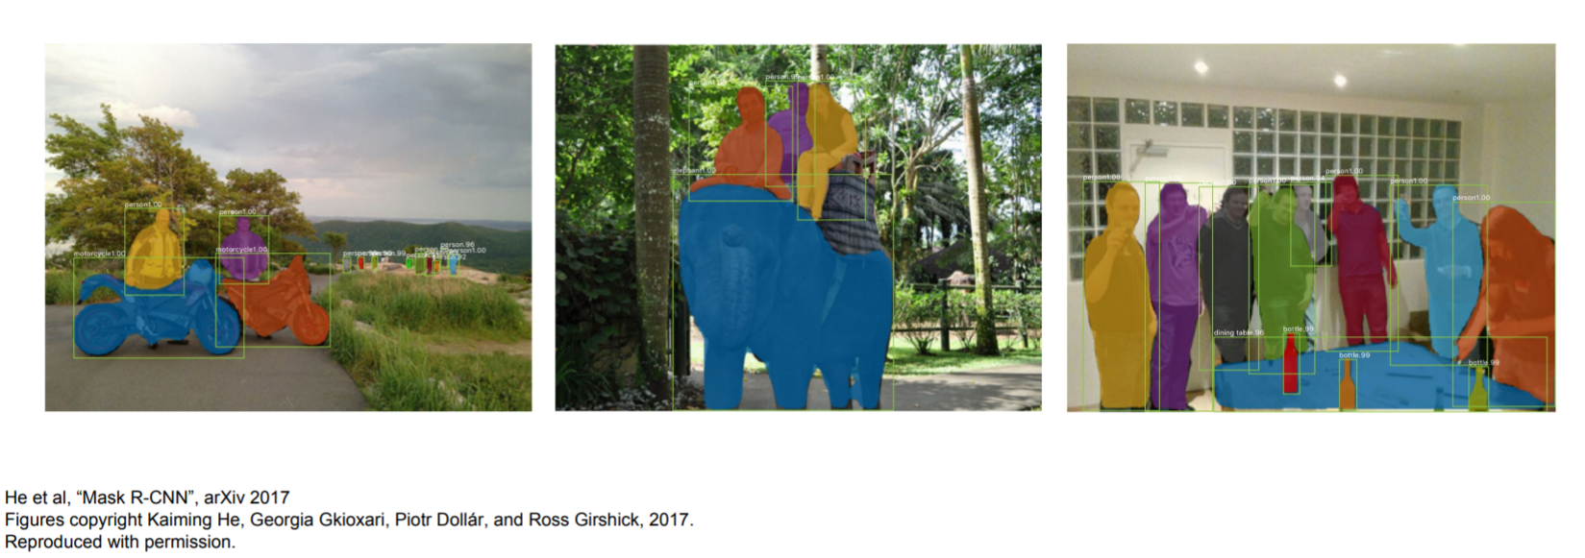
Excellent results

Slide 56
Error rate came from ~25% to ~5%
Source: Huang et al., Communications ACM 01/2016

Slide 57

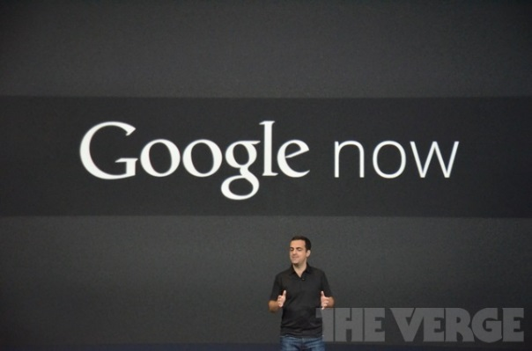
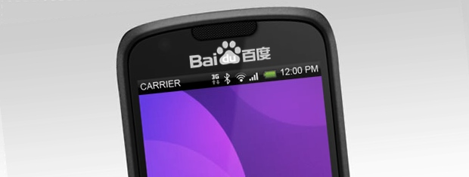


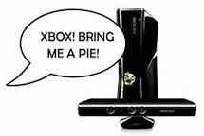

Impact of deep learning in speech technology

Slide 58
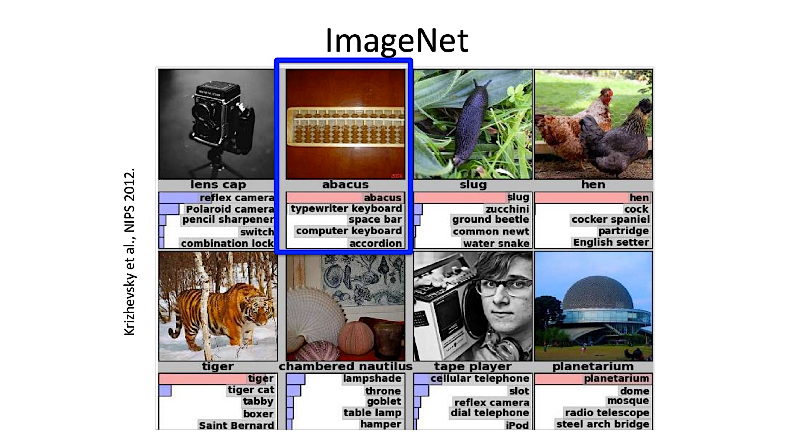

Slide 59
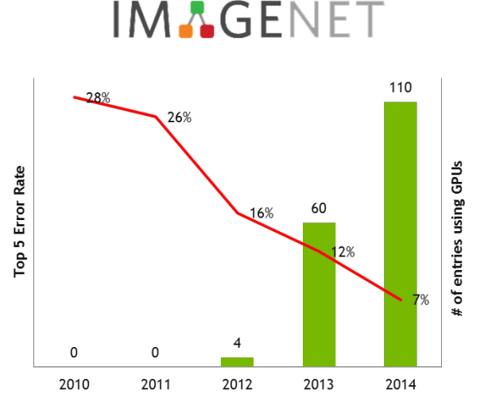
Large Scale Visual Image Challenge
Error rate came from ~28% to ~5% > Better than Human Judge !!

Slide 60
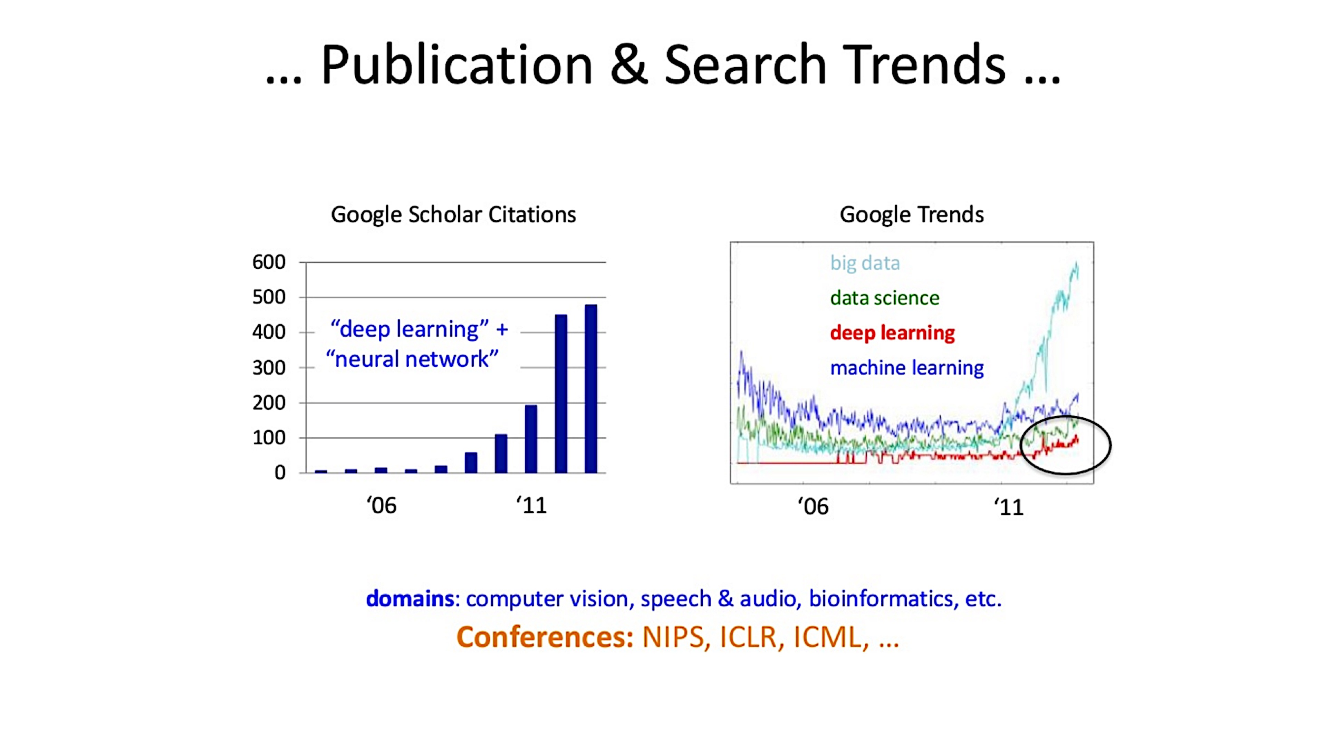

Slide 61
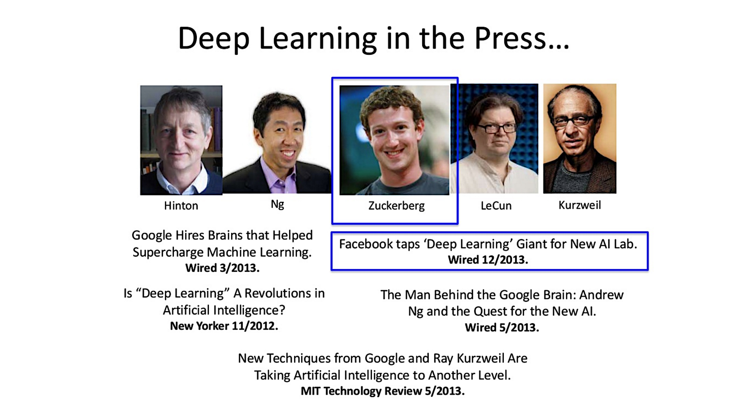

Slide 62
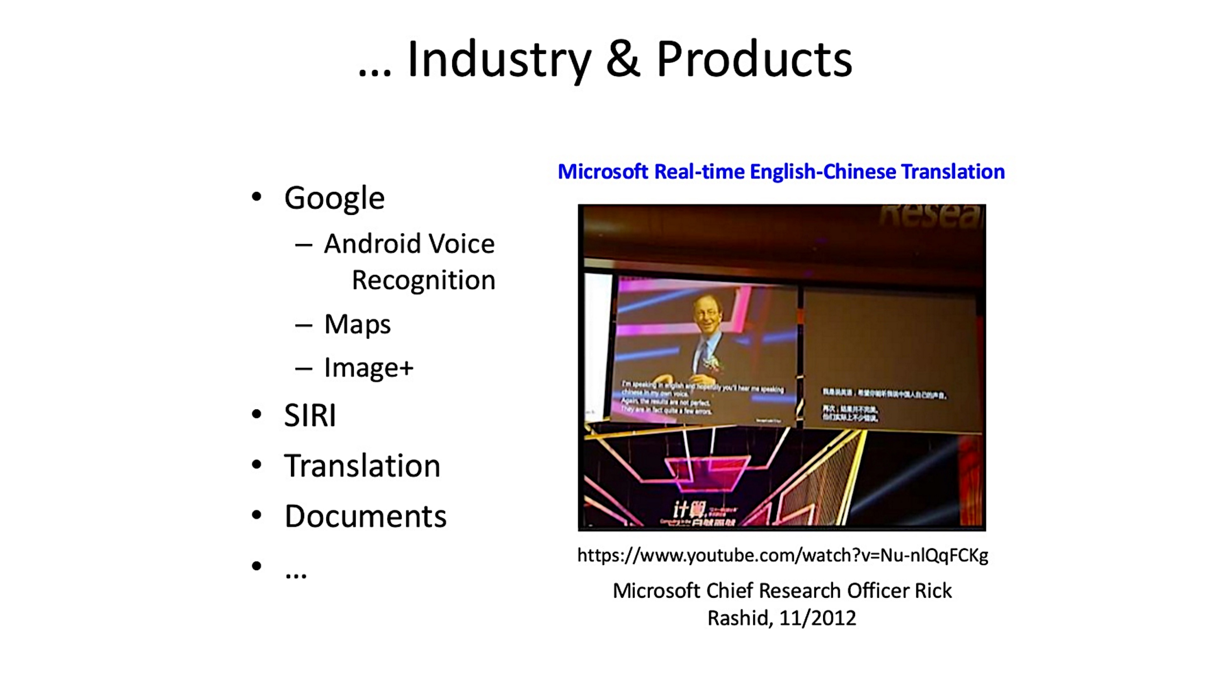

Slide 63
End.

